Slide 1
CREDIT EDA CASE STUDY
In this case study, we are applying EDA in a real business scenario. Apart from applying the techniques, we are also developing a basic understanding of risk analytics in banking and financial services and understanding how data is used to minimize the risk of losing money while lending to customers
By Vibhuti Koldiya

Slide 2
Problem Statement :
Objectives :
Identify key factors influencing payment difficulties via Exploratory Data Analysis (EDA).
Utilize EDA techniques to uncover insights that enhance decision-making in the loan approval process.
Business Goals :
Improve loan approval accuracy.
Optimize the loan application process.
Refine risk assessment strategies.
Implement data-driven actions.

Slide 3
Dataset :
'application_data.csv' contains all the information of the client at the time of application. The data is about whether a client has payment difficulties.
'previous_application.csv' contains information about the client’s previous loan data. It contains the data on whether the previous application had been Approved, Cancelled, Refused or Unused offer.

Slide 4
Assumptions :
Missing Data Handling:
No obligation to replace missing values.
Consider removal if necessary.
Impute: mean/median for numerical, mode for categorical.
Outlier Identification:
Identify outliers, don't remove.
Use visualizations like box plots and scatter plots.
Data Imbalance:
Address imbalance in target variable.
Visualize imbalance ratios using charts.
Correlation Analysis:
Segment data based on target variable.
Analyze correlations within each segment.
Explore top correlations for insights.

Slide 5
Approaches & Methodology :
Data Exploration:
Overview of the dataset.
Checking basic statistics, data types, and structure.
Identifying key variables.
Handling Missing Data:
Discussing the decision on handling missing values (e.g., removal or imputation).
Mentioning the method used for imputation (mean/median for numerical, mode for categorical).
Outlier Identification:
Highlighting the importance of understanding outliers.
Mentioning visualization techniques used (box plots, scatter plots).
Data Imbalance Analysis:
Explaining the approach to address data imbalance in the target variable.
Visualizing data imbalances using bar charts or pie charts.
Correlation Analysis:
Describing the segmentation of data based on the target variable.
Emphasizing the analysis of correlations within each segment.
Mentioning the exploration of top correlations for insights.

Slide 6
UNIVARIATE ANALYSIS FOR TARGET 0 & TARGET 1

Slide 7
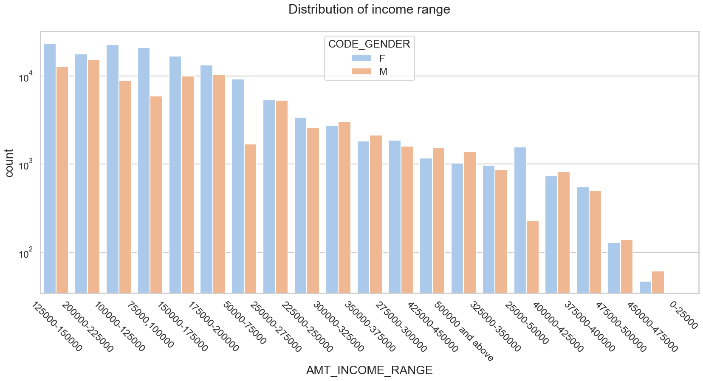
Distribution of Income range Target 0
Insights :
Female counts are higher than male.
Income range from 100000 to 200000 is having more number of credits.
This graph show that females are more than male in having credits for that range.
Very less count for income range 400000 and above.

Slide 8
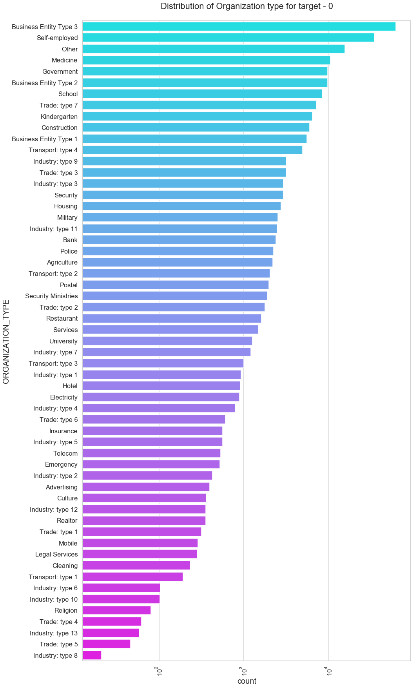
Distribution of organization Target 0 type
Insights :
Clients which have applied for credits are from most of the organization type ‘Business entity Type 3’ , ‘Self employed’ , ‘Other’ , ‘Medicine’ and ‘Government’.
Less clients are from Industry type 8,type 6, type 10, religion and trade type 5, type 4.

Slide 9
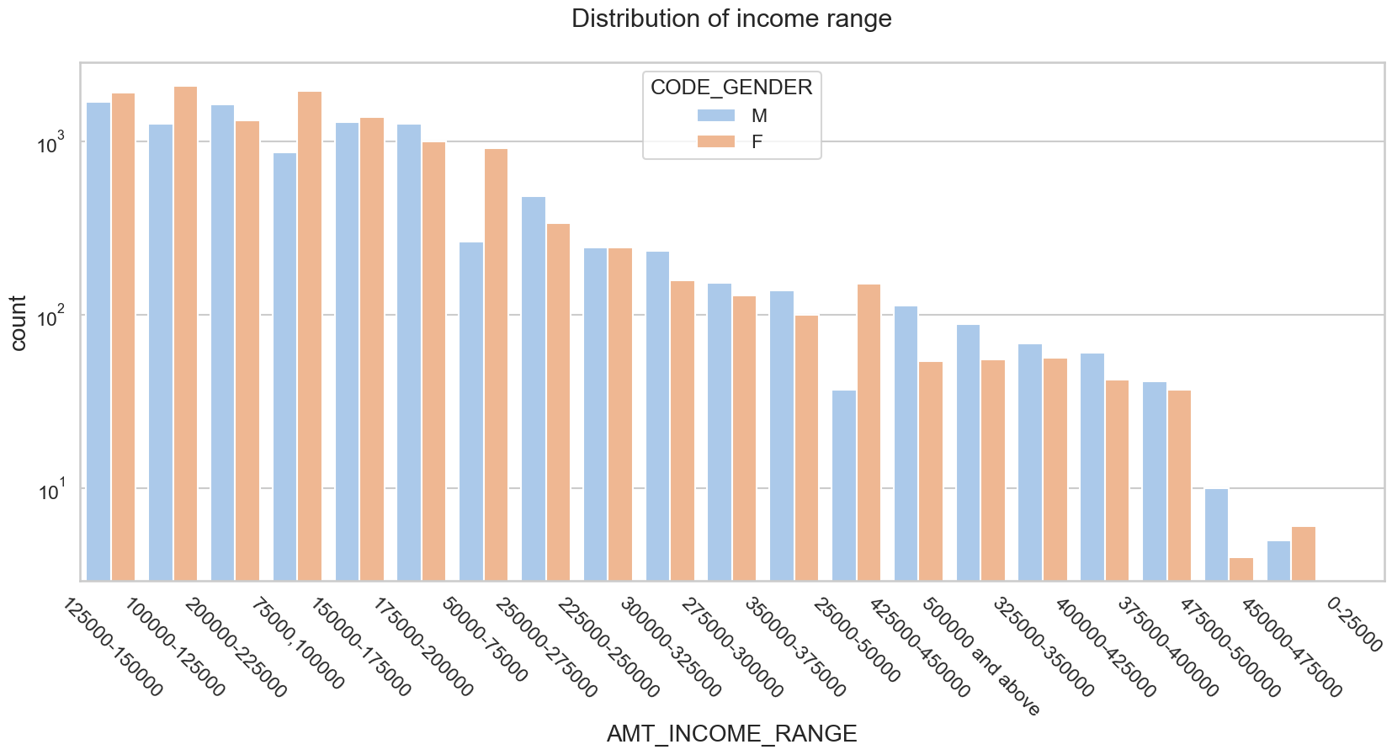
Distribution of Income range Target 1
Insights :
Male counts are higher than female.
Income range from 100000 to 200000 is having more number of credits.
This graph show that males are more than female in having credits for that range.
Very less count for income range 400000 and above.

Slide 10

Distribution of Income range Target 1
Insights :
Clients which have applied for credits are from most of the organization type ‘Business entity Type 3’ , ‘Self employed’ , ‘Other’ , ‘Medicine’ and ‘Government’.
Less clients are from Industry type 8,type 6, type 10, religion and trade type 5, type 4.
Same as type 0 in distribution of organization type.

Slide 11
Correlation For TARGET 0
Points to be concluded from the graph presented after -
Credit amount is inversely proportional to the date of birth, which means Credit amount is higher for low age and vice-versa.
Credit amount is inversely proportional to the number of children client have, means Credit amount is higher for less children count client have and vice-versa.
Income amount is inversely proportional to the number of children client have, means more income for less children client have and vice-versa.
less children client have in densely populated area.
Credit amount is higher to densely populated area.
The income is also higher in densely populated area.

Slide 12
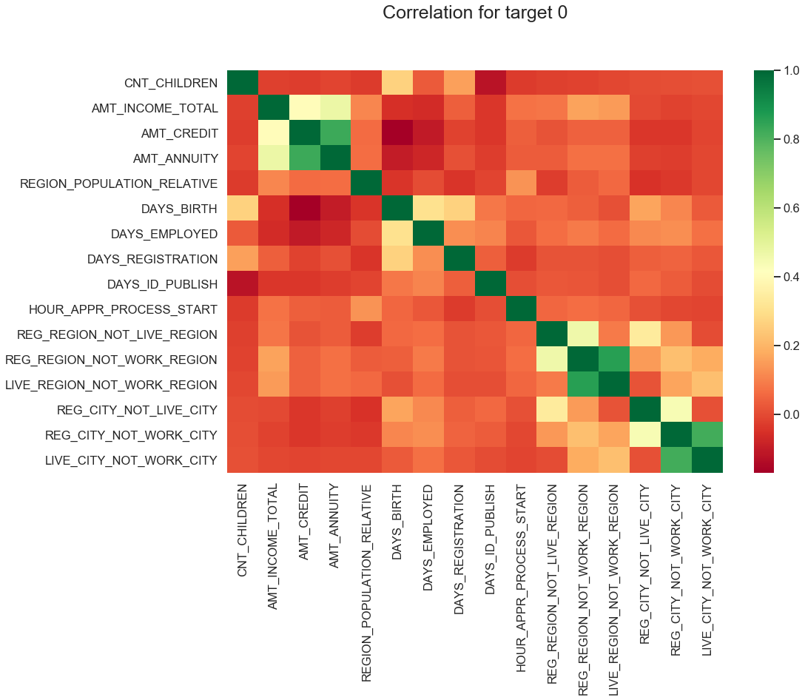

Slide 13
Correlation For TARGET 1
Following heat map for Target 1 is also having quite a same observation just like Target 0. But for few points are different. They are listed below.
The client's permanent address does not match contact address are having less children and vice-versa
The client's permanent address does not match work address are having less children and vice-versa

Slide 14
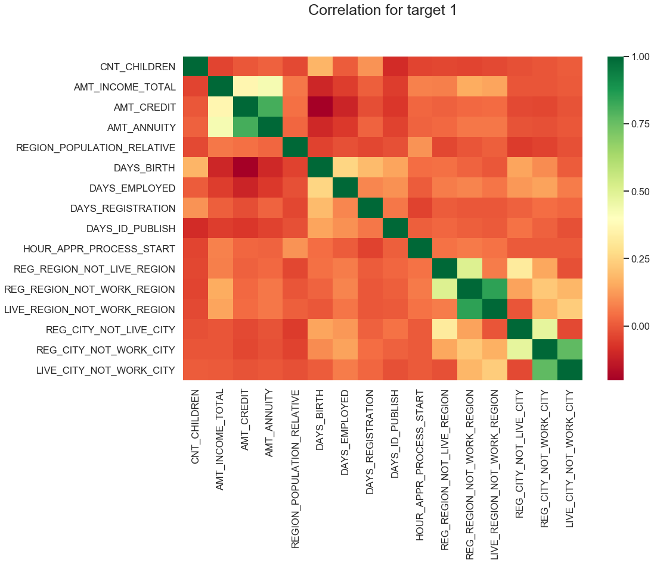

Slide 15
BIVARIATE ANALYSIS FOR TARGET 0 & TARGET 1

Slide 16
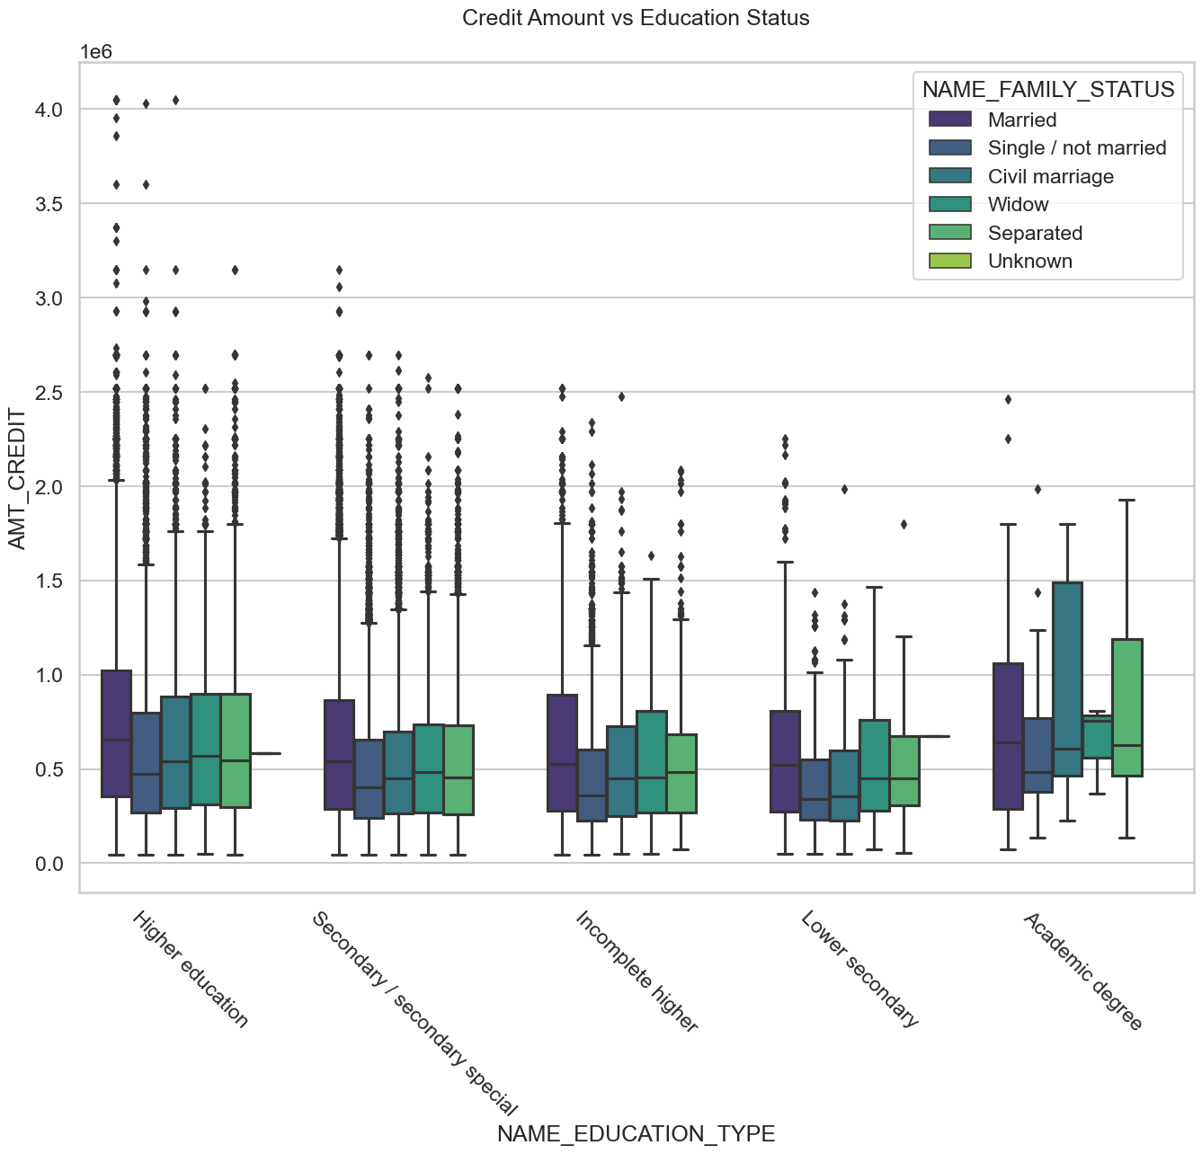
Credit amount vs Education Status Target 0
Insights :
Family status of 'civil marriage', 'marriage' and 'separated' of Academic degree education are having higher number of credits than others.
Higher education of family status of 'marriage', 'single' and 'civil marriage' are having more outliers.
Civil marriage for Academic degree is having most of the credits in the third quartile.

Slide 17
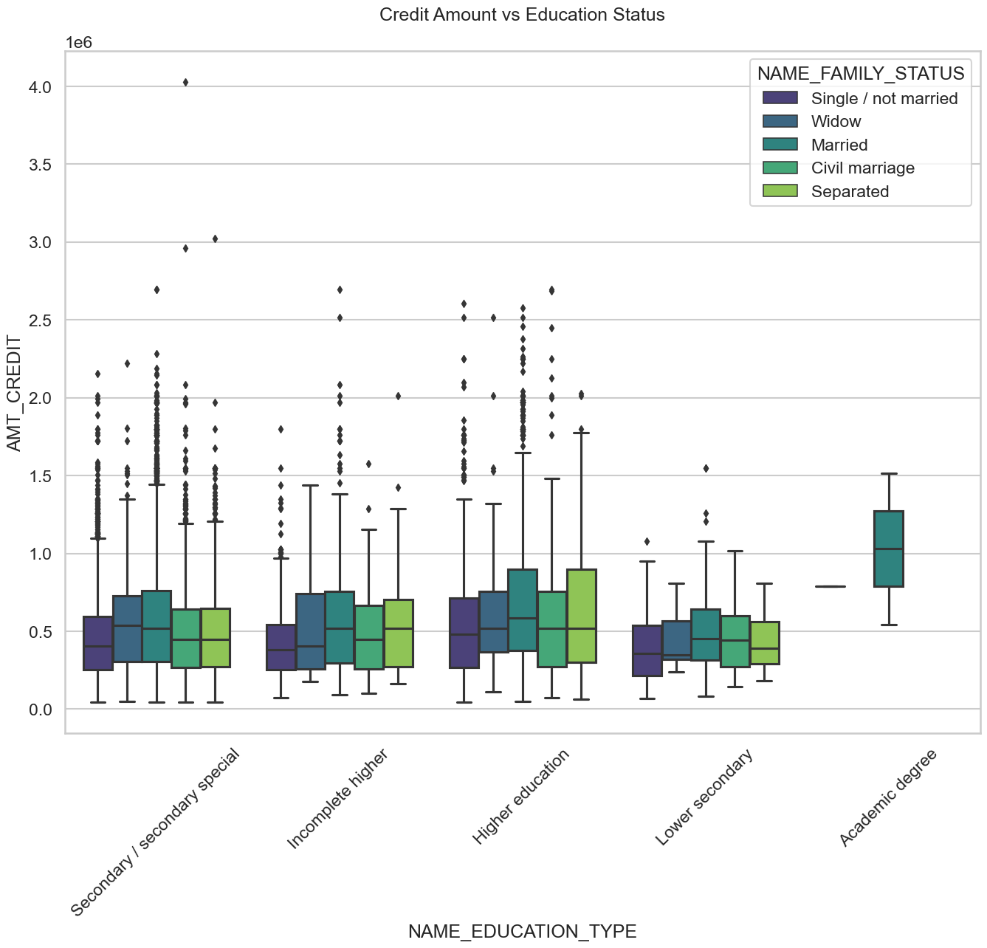
Credit amount vs Education Status Target 1
Insights :
Quite similar from Target 0, we can say that Family status of 'civil marriage', 'marriage' and 'separated' of Academic degree education are having higher number of credits than others.
Most of the outliers are from Education type 'Higher education' and 'Secondary’.
Civil marriage for Academic degree is having most of the credits in the third quartile.

Slide 18
MERGE DATASET UNIVARITE & BIVARIATE ANALYSIS

Slide 19
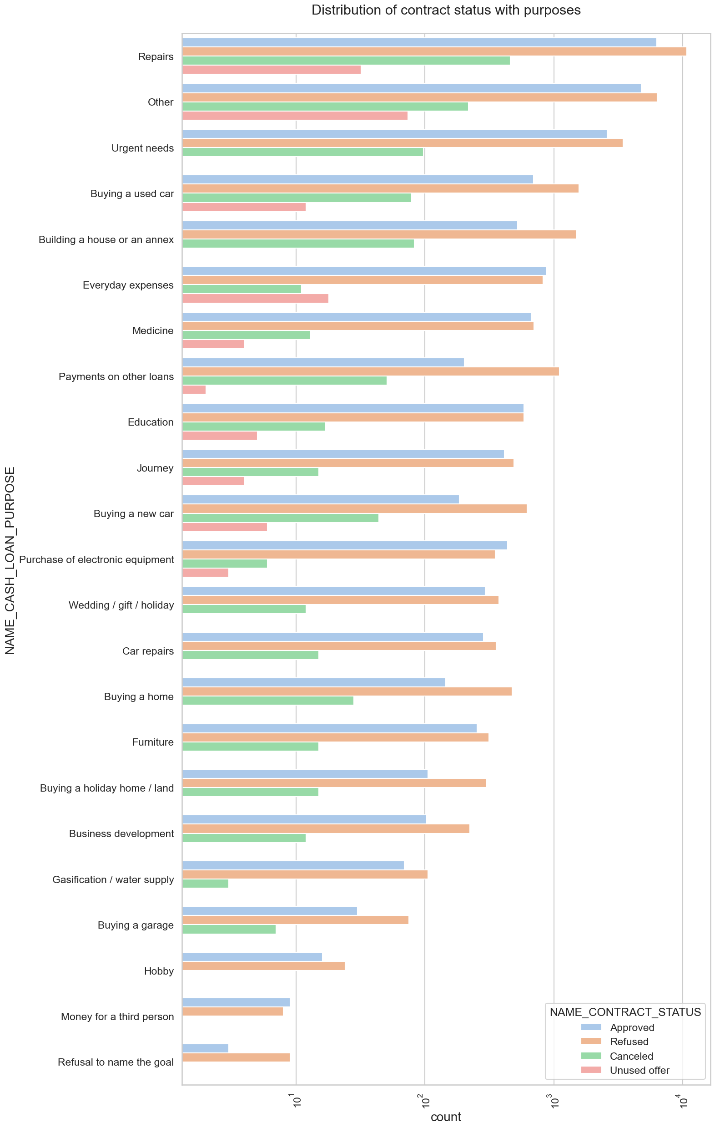
Distribution of contract status with purposes
Insights :
Most rejection of loans came from purpose 'repairs'.
For education purposes we have equal number of approves and rejection
Paying other loans and buying a new car is having significant higher rejection than approves.

Slide 20
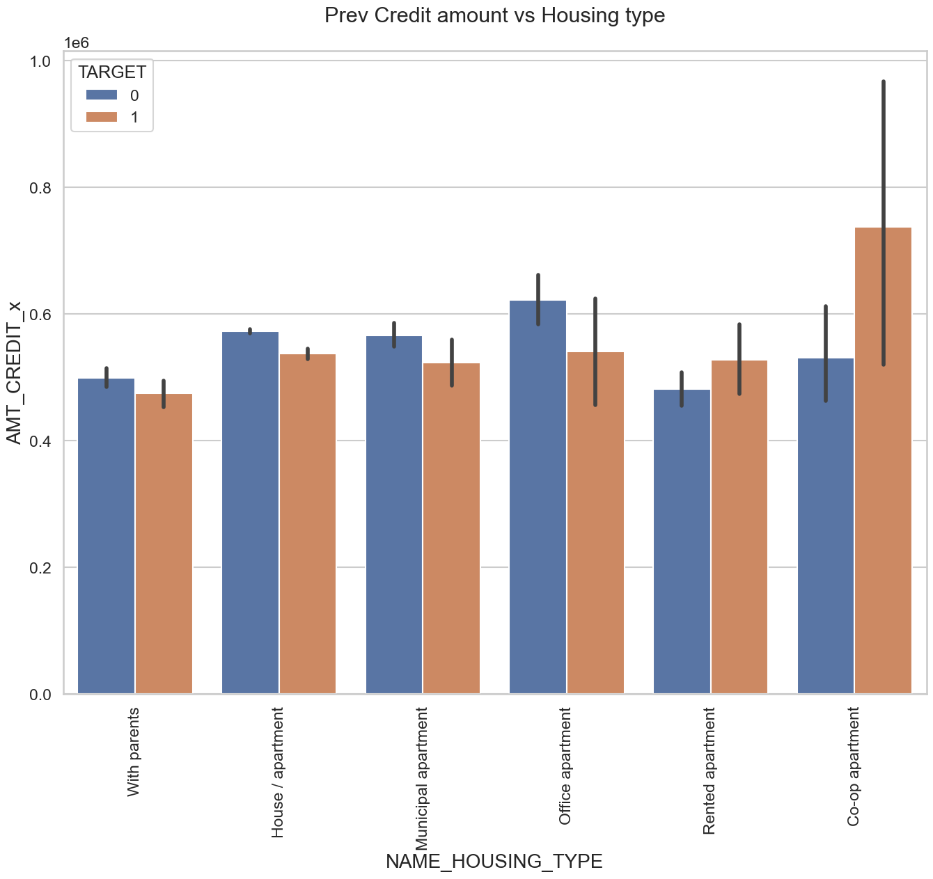
Prev Credit amount vs Housing type
Insights :
Here for Housing type, office apartment is having higher credit of target 0 and co-op apartment is having higher credit of target 1.
So, we can conclude that bank should avoid giving loans to the housing type of co-op apartment as they are having difficulties in payment.
Bank can focus mostly on housing type with parents or House\apartment or municipal apartment for successful payments.

Slide 21
Conclusion :
Banks should focus more on contract type ‘Student’ ,’pensioner’ and ‘Businessman’ with housing ‘type other than ‘Co-op apartment’ for successful payments.
Banks should focus less on income type ‘Working’ as they are having most number of unsuccessful payments.
Also with loan purpose ‘Repair’ is having higher number of unsuccessful payments on time.
Get as much as clients from housing type ‘With parents’ as they are having least number of unsuccessful payments.

Slide 22
THANK YOU…

